Slide 1
SPRING SECURITY
Instructor:

Slide 2
Table Content
1
Introduction
2
Authentication and Authorization
3
The Security Filter Chain
4
Interaction Flow
5
Spring Security with JDBC

Slide 3
Learning Goals
After the course, attendees will be able to:
Understand Spring Security Framework and its core technologies.
Know how to write a Web application with Spring Security.

Slide 4
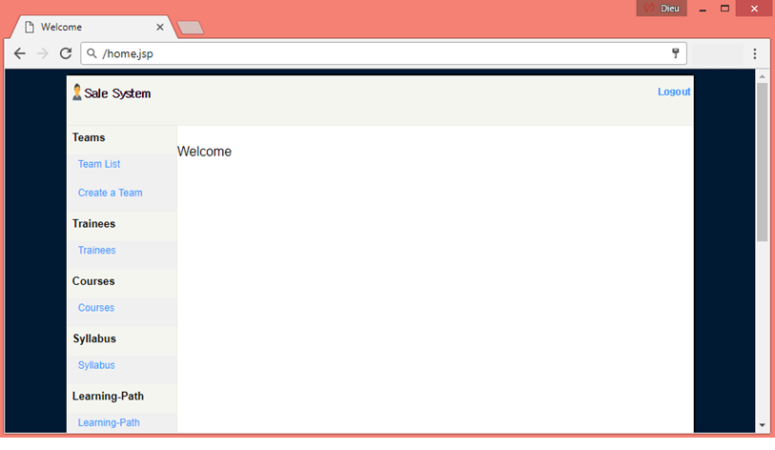
Introduction
ROLL_USER
ROLL_ADMIN
ROLL_ADMIN only

Slide 5

Introduction
Spring security is another major module in spring distribution and is supported only for applications developed using JDK 1.5 or higher.
Spring Security is a framework that focuses on providing both authentication and authorization to Java EE-based enterprise software applications.
Spring security has been divided into multiple jars and you should include them as your application need. Only the core module available in spring-security-core.jar is mandatory.

Slide 6
Introduction
spring-security-core
It contains core authentication and access-contol classes and interfaces.
spring-security-web
It contains filters and related web-security infrastructure code. It also enable URL based security which we are going to use in this demo.
spring-security-config
It contains the security namespace parsing code. You need it if you are using the Spring Security XML file for configuration.
spring-security-taglibs
It provides basic support for accessing security information and applying security constraints in JSPs.

Slide 7
Authentication and Authorization
It also provides authentication at view level and method level.
It can also provide you with a login page! Here are some things that it provides:
Provide capabilities for login and logout
Control access to a link based on the role of the user.
Provide the ability to hide certain portion of a page if a user does not have appropriate privileges.
Link to a database for authentication

Slide 8
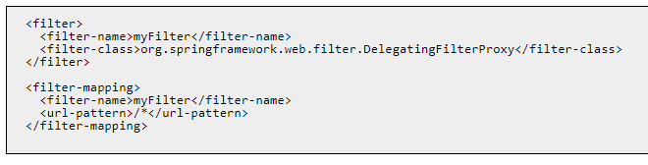
The Security Filter Chain
Spring Security’s web infrastructure is based entirely on standard servlet filters.
These filters are defined in web.xml file:

Slide 9
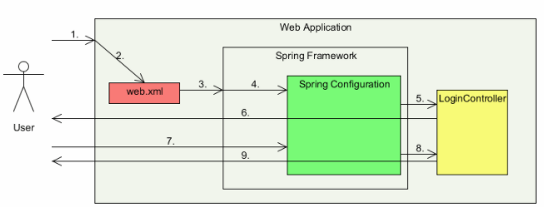
Interaction Flow
User accesses a URL on a web application
The web application refers to web.xml
The web.xml matches the URL pattern
The control is redirected to DispatcherServlet in Spring framework
Spring framework finds that the all URLs are secured and hence displays login page to the user
The user enters his login name and password
Spring framework validates the login name and password by using the entries in Spring configuration XML and redirects to the accessed original URL

Slide 10
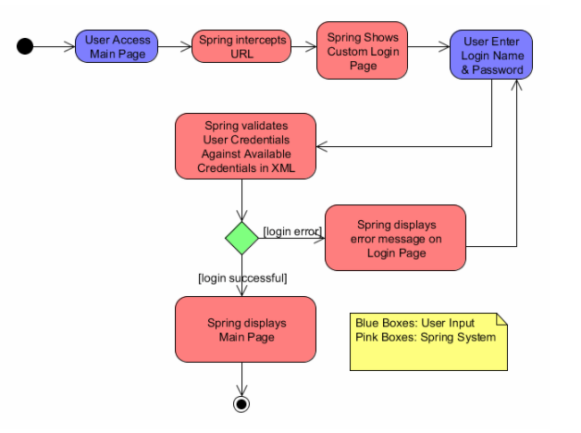
Interaction Flow Detail

Slide 11
Login Form Example
Only authorized user should be able to access home screen.
Unauthorized users should be presented with login screen.
Successful credentials should forward to home screen.
Unsuccessful credentials should forward to access denied screen.
There should be a link for logout of the application.

Slide 12
(1) Update project dependencies in pom.xml
<security.version>4.2.3.RELEASE</security.version>
// ..
<!--Security -->
<dependency>
<groupid>org.springframework.security</groupid>
<artifactid>spring-security-core</artifactid>
<version>${spring.version}</version>
<type>jar</type>
<scope>compile</scope>
</dependency>
<dependency>
<groupid>org.springframework.security</groupid>
<artifactid>spring-security-web</artifactid>
<version>${spring.version}</version>
<type>jar</type>
<scope>compile</scope>
</dependency>
<dependency>
<groupid>org.springframework.security</groupid>
<artifactid>spring-security-config</artifactid>
<version>${spring.version}</version>
<type>jar</type>
<scope>compile</scope>
</dependency>
<dependency>
<groupid>org.springframework.security</groupid>
<artifactid>spring-security-taglibs</artifactid>
<version>${spring.version}</version>
<type>jar</type>
<scope>compile</scope>
</dependency>

Slide 13
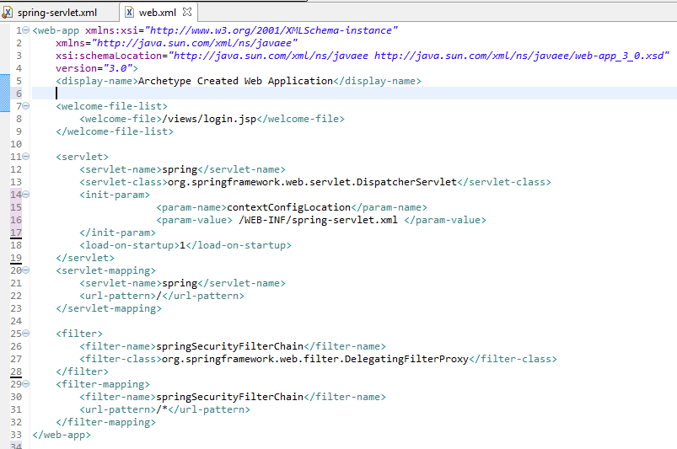
(2) Configure DelegatingFilterProxy in web.xml
Notes:
<web-app xmlns:xsi="http://www.w3.org/2001/XMLSchema-instance"
xmlns="http://java.sun.com/xml/ns/javaee"
xsi:schemaLocation="http://java.sun.com/xml/ns/javaee http://java.sun.com/xml/ns/javaee/web-app_3_0.xsd"
version="3.0">
<display-name>Archetype Created Web Application</display-name>
<welcome-file-list>
<welcome-file>/views/login.jsp</welcome-file>
</welcome-file-list>
<servlet>
<servlet-name>spring</servlet-name>
<servlet-class>org.springframework.web.servlet.DispatcherServlet</servlet-class>
<load-on-startup>1</load-on-startup>
</servlet>
<servlet-mapping>
<servlet-name>spring</servlet-name>
<url-pattern>/</url-pattern>
</servlet-mapping>
<filter>
<filter-name>springSecurityFilterChain</filter-name>
<filter-class>org.springframework.web.filter.DelegatingFilterProxy</filter-class>
</filter>
<filter-mapping>
<filter-name>springSecurityFilterChain</filter-name>
<url-pattern>/*</url-pattern>
</filter-mapping>
<context-param>
<param-name>contextConfigLocation</param-name>
<param-value>
/WEB-INF/spring-servlet.xml
/WEB-INF/application-security.xml
</param-value>
</context-param>
<listener>
<listener-class>org.springframework.web.context.ContextLoaderListener</listener-class>
</listener>
</web-app>

Slide 14
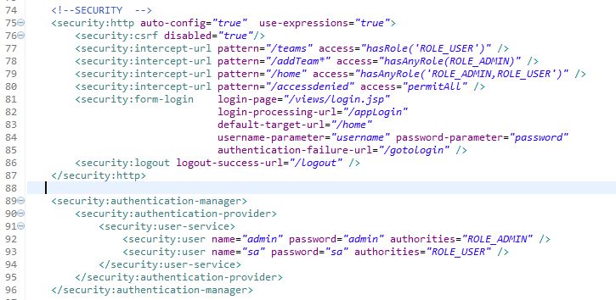
(3) Add security configuration
Namespace: xmlns:security=“http://www.springframework.org/schema/security”
and
http://www.springframework.org/schema/security http://www.springframework.org/schema/security/spring-security.xsd
Notes:
<security:http auto-config="true" use-expressions="true">
<security:csrf disabled="true"/>
<security:intercept-url pattern="/teams" access="hasRole('ROLE_USER')" />
<security:intercept-url pattern="/addTeam*" access="hasRole('ROLE_ADMIN')" />
<security:intercept-url pattern="/home" access="hasAnyRole('ROLE_ADMIN,ROLE_USER')" />
<security:intercept-url pattern="/accessdenied" access="permitAll" />
<security:access-denied-handler error-page="/gotologin" />
<security:form-login login-page="/views/login.jsp"
login-processing-url="/appLogin"
default-target-url="/home"
username-parameter="username" password-parameter="password"
authentication-failure-url="/gotologin" />
<security:logout logout-success-url="/logout" />
</security:http>
<security:authentication-manager>
<security:authentication-provider>
<security:user-service>
<security:user name="admin" password="admin" authorities="ROLE_ADMIN, ROLE_USER" />
<security:user name="sa" password="sa" authorities="ROLE_USER" />
</security:user-service>
</security:authentication-provider>
</security:authentication-manager>

Slide 15
(3) Add security configuration
http: Include configuration related url level security. This element is the parent for all web-related namespace functionality.
auto-config: Inclused some basic services. It is shorthand for –
<http>
<form-login />
<http-basic />
<logout />
</http>
use-expressions: It is here to use expressions to secure individual URLs. These expressions can be e.g. hasRole([role]), hasAnyRole([role1,role2]), permitAll, denyAll etc.

Slide 16
Explain: Common Built-In Expressions
The base class for expression root objects is SecurityExpressionRoot. This provides some common expressions which are available in both web and method security.
Expression | Description
hasRole([role]) | Returns true if the current principal has the specified role.
hasAnyRole([role1,role2]) | Returns true if the current principal has any of the supplied roles (given as a comma-separated list of strings)
principal | Allows direct access to the principal object representing the current user
authentication | Allows direct access to the current Authentication object obtained from the SecurityContext
permitAll | Always evaluates to true
denyAll | Always evaluates to false
isAnonymous() | Returns true if the current principal is an anonymous user
isRememberMe() | Returns true if the current principal is a remember-me user
isAuthenticated() | Returns true if the user is not anonymous
isFullyAuthenticated() | Returns true if the user is not an anonymous or a remember-me user

Slide 17

Explain: Web Security Expressions
To use expressions to secure individual URLs, you would first need to set the use-expressions attribute in the <http> element to true.
Spring Security will then expect the access attributes of the <intercept-url> elements to contain Spring EL expressions.
Example:
<http use-expressions="true">
<intercept-url pattern="/admin*"
access="hasRole('admin') and hasIpAddress('192.168.1.0/24')"/>
...
</http>

Slide 18
(3) Add security configuration
intercept-url: This will match the requested url pattern from request and will decide what action to take based on access value.
form-login: This will come into picture when user will try to access any secured URL. A login page mapped to “login-page” attribute will be served for authentication check. If not provided, spring will provide an inbuilt login page to the user. It also contains an attribute for default target if login success, or login failure due to invalid.
access-denied-handler: redirect the user to other page when “Etat HTTP 403 - Access is denied”;
logout: This will help to find the next view if logout is called in the application.

Slide 19
Spring Security with JDBC
Create 2 tables:
CREATE TABLE [dbo].[Users](
[user_id] [int] IDENTITY(1,1) PRIMARY KEY NOT NULL,
[user_name] [varchar](50) NOT NULL,
[email] [varchar](50) NOT NULL,
[password] [varchar](50) NOT NULL,
[enabled] [tinyint] NOT NULL,
[passwords] [varchar](255) NULL,
[users_name] [varchar](255) NULL,
)
CREATE TABLE [dbo].[Users_Roles](
[user_role_id] [int] PRIMARY KEY NOT NULL,
[user_id] [int] NOT NULL,
[authority] [varchar](45) NOT NULL,
CONSTRAINT uni_user UNIQUE([authority], [user_id]),
CONSTRAINT fk_user FOREIGN KEY ([user_id]) REFERENCES dbo.Users([user_id])
)

Slide 20
Spring Security with JDBC
Some initial data to start with:
INSERT [dbo].[Users] ([user_id], [user_name], [email], [password], [enabled])
VALUES (1, N'dieunguyen', N'dieun@fsoft.com.vn', N'12345', 1),
(2, N'dieunt1', N'dieunt1@fsoft.com.vn ', N'sa', 1),
(3, N'admin', N'admin@fsoft.com', N'admin', 1)
INSERT INTO dbo.Users_Roles([user_role_id], [user_id], [authority])
VALUES (100, 2, 'ROLE_ADMIN'),
(101, 3, 'ROLE_ADMIN'),
(102, 1, 'ROLE_USER');

Slide 21
Update security configuration
<security:authentication-manager>
<security:authentication-provider>
<security:jdbc-user-service
data-source-ref="dataSource"
users-by-username-query="select user_name, password, enabled from USERS
where user_name = ?"
authorities-by-username-query="select u.user_name, ur.authority from
USERS u, USERS_ROLES ur where u.user_id = ur.user_id
and u.user_name = ? " />
</security:authentication-provider>
</security:authentication-manager>

Slide 22
SUMMAY
1
Introduction
2
Authentication and Authorization
3
The Security Filter Chain
4
Interaction Flow
5
Spring Security with JDBC

Slide 23

Thank you
23

